Slide 1

Welcome to the World of
Plumbing Apprenticeship
Notes:
Welcome to the world of Plumbing Apprenticeship.
In front of you is a packet, we will be going through these documents, please do not move ahead or sign a document until asked to do so.
There is also a small pad of paper, this is for taking notes during the presentation. If you have any questions during the presentation please write them down, if you do not get the answer during the presentation itself, we will have a question and answer section at the end.

Slide 2
Requirements On File
Copy of Legal ID
Driver’s License
State ID
Passport
Birth Certificate
High School Diploma or GED
High School Transcripts
Work History & Verification
Notes:
Open Enrollment: These documents should already be on file.
Exceptions: These documents should have been provided prior to setting this appointment, if not please provide them at this time.
*Verify that all requirements are in packet prior to proceding.

Slide 3
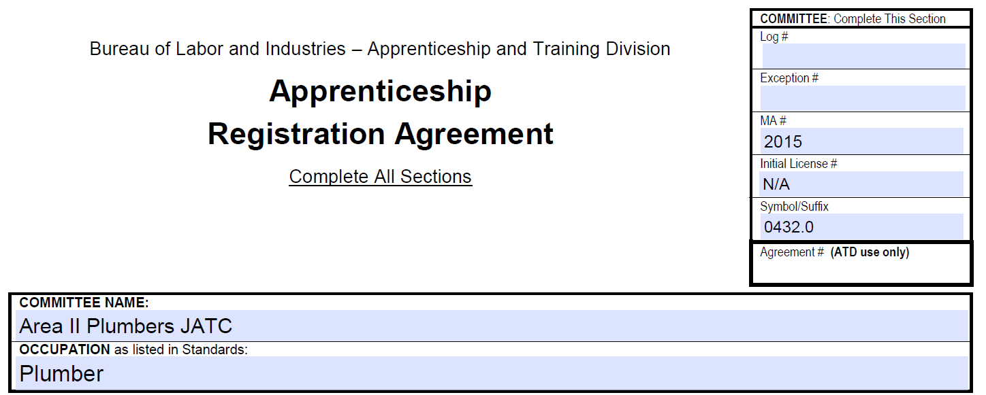
Apprentice Registration Agreement
BOLI (Bureau of Labor and Industry) Form
Notes:
This form is a BOLI (Bureau of Labor and Industry) form, this is not an Area II Plumbers JATC form.

Slide 4
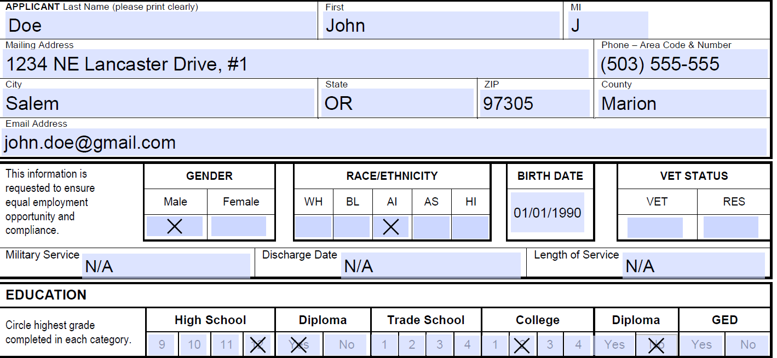
Apprentice Registration Agreement
Verify Personal Information
Notes:
Please verify that all information is correct, write corrections on form, we will make corrections and reprint the form prior to signing.
Please do not move forward without instruction.

Slide 5
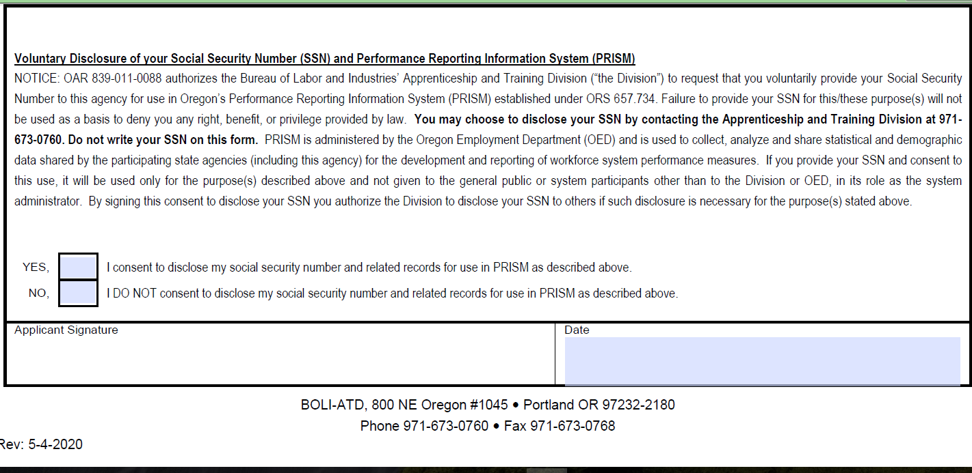
Apprentice Registration Agreement
PRISM
Answer – Yes or No, Sign and Date
Does not affect your ability to join the program
Notes:
PRISM (Performance Reporting Information System) is a data gathering program for BOLI. This is optional, your choice will not affect your status. Please select Yes or No.
Sign and date the form at the bottom of the page.

Slide 6
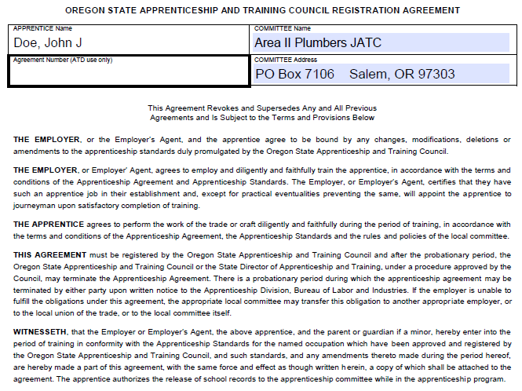
Apprentice Registration Agreement
Turn over
Read this section
Notes:
On the back of the Agreement please read the top section. You should always read anything you sign!
Do not sign until advised to do so.

Slide 7
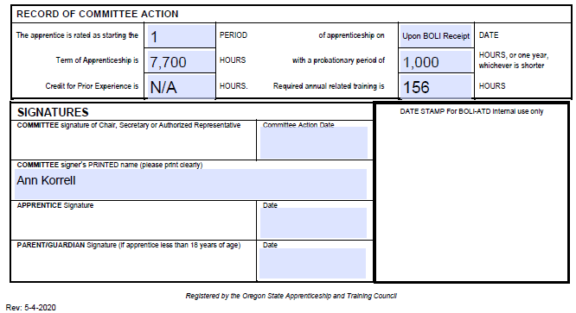
Apprentice Registration Agreement
Sign – Apprentice Signature
Date
Notes:
At the bottom of the page the section below the printed name, which is already typed onto the page, is for your signature. Please sign and date the agreement. Once signed please hand in this form.

Slide 8
Apprentice Registration Agreement
Apprentices will received a digital
version of their Registration packet
once BOLI returns a certified /
stamped Registration Agreement
to Area II Plumbers JATC
Notes:
We will email you a complete locked copy of the registration packet once we receive the BOLI stamped Registration Agreement from BOLI in the mail. Your Agreement Number (assigned by BOLI) will be the password.

Slide 9
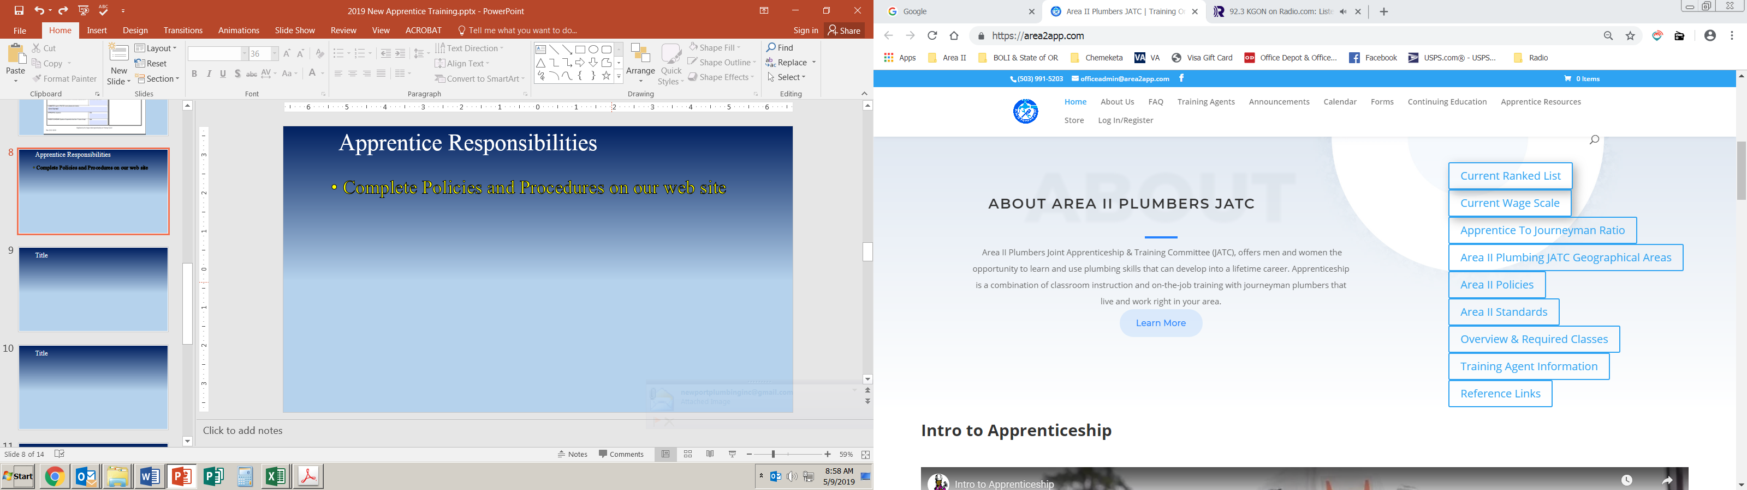
Apprentice Responsibilities
Complete Policies and Procedures
on Area II Plumbers JATC web site
Notes:
The next paper in the is an excerpt from Area II Plumbers JATC Policies & Procedures pertaining to the Responsibilities of an Apprentice, you will retain this page as well as the next page which is another excerpt from Area II Plumbers JATC Policies & Procedures pertaining to Conflict Resolution.
The complete version of the Policies & Procedures is available on our web page, as is the complete copy of the Standards. We recommend you take the time to read them.

Slide 10
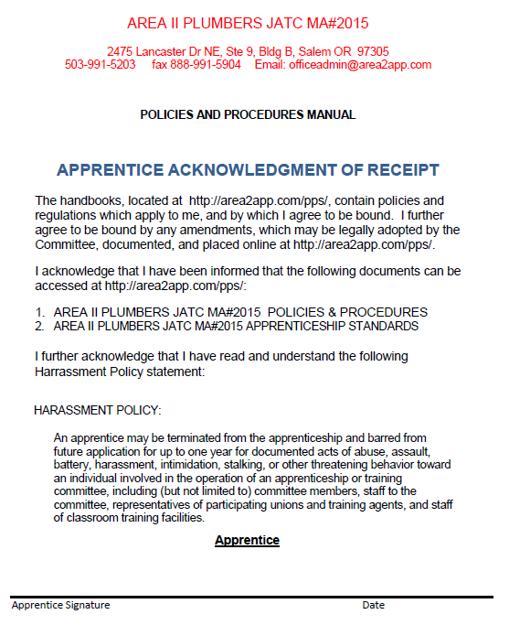
Apprentice Responsibilities
Apprentice Duties
and Responsibilities
Complete versions
of Policies &
Procedures and
Standards online
Sign Apprentice
Acknowledgement
of Receipt
Notes:
The next page in the packet is the Acknowledgement of Receipt Form, stating that you were made aware of where to locate Area II Plumbers JATC Policies & Procedures, and Standards. Sign the form and hand it in.

Slide 11
Declinations
Apprentices may decline 1 job offer
during their Apprenticeship
A second declination will result in
Cite to Appear before the Committee
Disciplinary Probation
Cancelation
Notes:
*You currently have a Training Agent, however, if for any reason this relationship were terminated you will be placed on the Out-of-Work list. This list is made available to any Training Agent looking for an Apprentice.
While in the Apprenticeship if you find yourself on the Out-of-Work list for any reason you will may decline one job offer is you wish. However, a second declination will result in a citation to appear before the Committee, disciplinary Probation or Cancellation. It is the responsibility of an Apprentice to remain employed by a Area II Plumbers JATC Registered Training Agent throughout their time in the Apprenticeship.

Slide 12
Wage Scale
Wage Survey of Area II Plumbers JATC
Training Agents
Done each Autumn
Effective first of year
Training Agents investing in Apprentice
Start off making over $16.00/hr
Training Apprentices – paying to learn
Pay fees to Area II Plumbers JATC @ month
To be a Training Agent
For each Apprentice
Notes:
Area II Plumbers JATC is required to perform a yearly Wage Survey, this is done in the Autumn, and the resulting changes in the wage scale become effective at the first of the year. As Apprentices are paid a specific percentage of the average Journeyman’s wage (depending on what Period the Apprentice is in), this survey determines not only what Journeymen in our area are making, but what Apprentices in our Area will be making.
Training Agents invest in their Apprentices. Before you’ve had any training at all they are already paying you over $16.00/hour! Essentially they are paying you to learn. On top of this the Training Agents pay Area II Plumbers JATC each month both a training fee, and a fee for each Apprentice. Training Agents don’t begin to break even on their investment for the first 2 years an Apprentice is in the program.
The only people in the program who are paid are the two members of the office staff, all the members of the Committee and Trust are volunteers. So, as you can see Training Agents are not the only ones investing in you as an Apprentice.

Slide 13
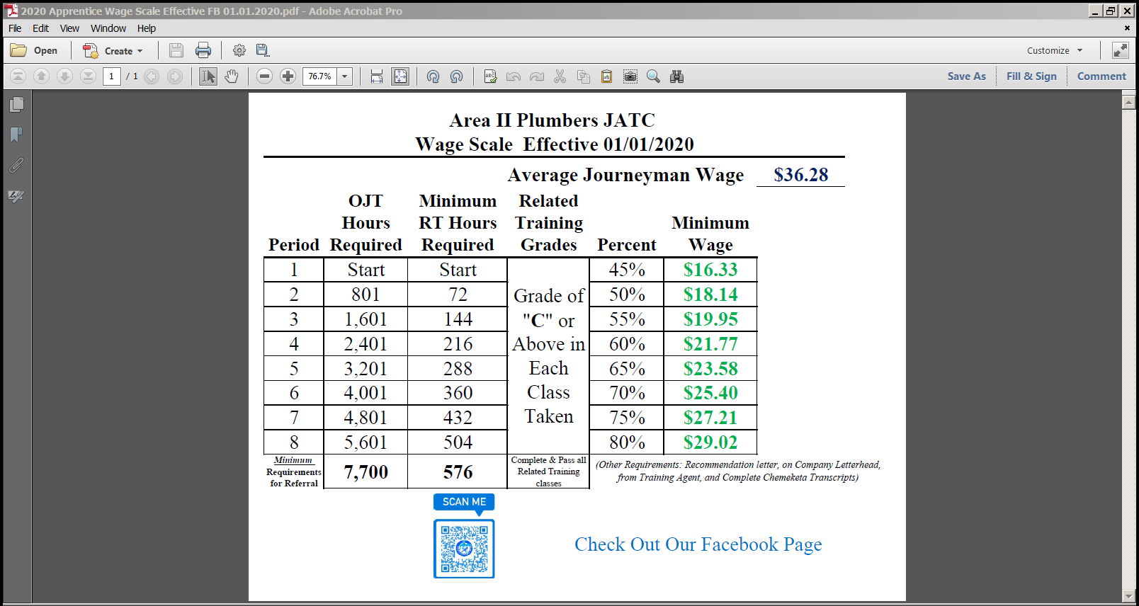
Wage Scale
Start Off making 45% of current Average Journeyman Wage
Notes:
Currently the Average Journeyman Wage is $36.28/hour. As a first Period Apprentice you are making 45% of the Journeyman’s wage - $16.33/hour.

Slide 14

Wage Scale
Re-rate done twice a year – currently January & July If Apprentice meets requirements will be rated up to Next period – add another 5% to percentage of Current Journeyman Wage
Notes:
There are eight (8) Periods in the Apprenticeship, each one increasing your percentage of the Journeyman’s wage by 5%. Moving up to the next Period is called Re-Rating.
Re-rates are done twice a year, currently this is scheduled for February and July. To be Re-rated you must meet the minimum requirements for the next Period, and be in good standing.

Slide 15
Initial Probation
Apprentices are considered Probationary for the first 1,000 hours or 1 year whichever comes first.
Probationary Apprentices who do not follow Policies & Procedures may be cancelled, and do not have the right to appeal.
Notes:
During the first 1,00 hours or 1 year, whichever comes first, Apprentices are in their initial probationary period. During this time actions that are contrary to Policies & Procedures will result in cancellation of Apprenticeship without the right to appeal.

Slide 16
Wage Scale
Available on Area II Plumbers JATC web site
Notes:
The Current Wage Scale is also available on the Area II Plumbers JATC web page. When the Wage Scale is updated at the first of the year, it will be updated on our webpage.

Slide 17
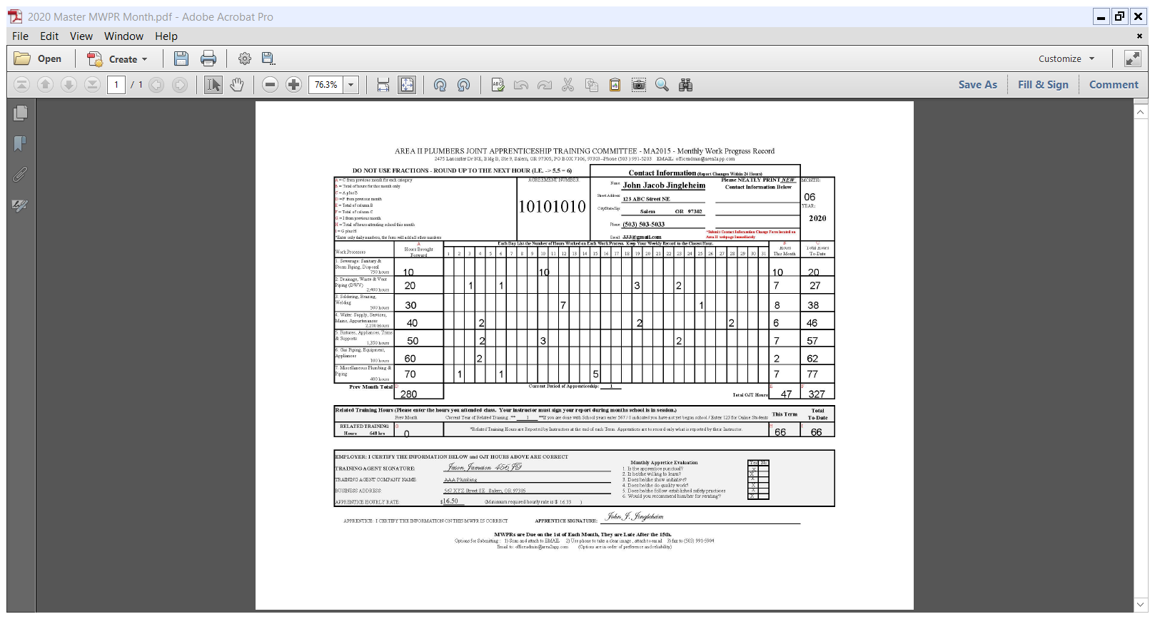
MWPR - Monthly Work Progress Report
BOLI issues each Apprentice an Agreement number
This number allows the Division of Building Codes to
look up an Apprentice and verify that they are registered while they are waiting for their Apprentice License to come via USPS from BOLI
Notes:
The next sheet in your packet is for you to keep, this is an example MWPR – Monthly Work Progress Report. This will be your best friend and worst enemy for the next four (4) years! ☺
At the top is the BOLI issued agreement number, we will receive this from BOLI via email before you receive your Apprentice License (via mail). Once we receive this number we will generate an MWPR for you and email it to you. Once you receive your MWPR you may then begin recording your hours and acting as an Apprentice. You will need to carry this form with you every work day.
Many Apprentices use a clipboard with a compartment, or their Code Book, to hold their MWPR during the month. This not only protects the form, but also allows them to have a hard surface to write on as they fill in their information daily.

Slide 18
MWPR
1. Apprentice contact information will be entered by Area II Plumbers JATC
2. Change of contact information should be listed in this section. Apprentices must report changes in Employment or Contact information using forms located on the Area II Plumbers JATC website within 24 hours.
Notes:
The next section is your personal information, we will enter this prior to sending you the form. Although the empty section next to your contact information is for you to enter any new contact information, be sure to also submit the Change of Contact Information on the Forms page of our website. We will cover more on this later.

Slide 19
MWPR
Enter month
Can be entered as June or 06
2. Year will be entered prior to Area II Plumbers JATC emailing MWPR to you
You will receive an update MWPR at the beginning of each calendar / school year, if you change Training Agent, or when you are Re-rated
Notes:
The next section is the month and year, the year will be pre-entered, you will need to enter the month. You may spell out the month, or enter it’s number, either is acceptable, as long as it is correct and legible.
We will provide you with an updated MWPR form when there is a change, such as: the beginning of each calendar year or school year, if you change Training Agents, or when you are Re-rated.

Slide 20
MWPR
This section is used to record an Apprentice’s OJT (On the Job Training hours) .
This section is split into 31. Enter hours for each Process in the appropriate date, total them in the Hours This Month Column
Notes:
This section is where you will enter your OJT (On the Job Training hours). It is laid out in thirty-one (31) columns, for each day of the month. And seven (7) rows for each of the Processes. At the end of the month you will total each Process and enter the total into the Hours This Month Column. You will then add each Processes monthly total together to get your total OJT for the month. Most Apprentices average between 130 to 180 a month, though it’s not unusual during the summer months to see this average rise to 180 to 220 or even more.
Be sure you are recording your numbers properly. Some jobs may fall into more than one Process, consult your Training Agent if you are not sure. Recording your hours incorrectly will cost you in the end; if you have reached the seventy-seven thousand (7,700) minimum total OJT hours, but have not met the minimum requirement in a process you will not be able to be recommended to take the State Exam until you have met that process’ minimum as well.

Slide 21
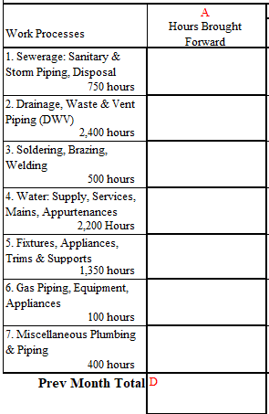
MWPR - Processes
Notes:
This is an expansion of the Processes, the numbers in the lower right corner are the minimum required hours for each Process.

Slide 22
MWPR
Add Hours Brought Forward to Hours This Month, place totals in Total Hours To-Date Column (These hours become the next Month’s Hours Brought Over
Notes:
The first column contains Hours Brought Forward, these are the Total Hours To-Date from the previous month’s MWPR. This Apprentice is fairly new and has a total of 260 hours to carryover.
Once you have totaled the monthly numbers you will now figure your running total into the Total Hours To-Date column. This is done by adding the Hours Brought Forward and the Hours This Month totals. These numbers then become your Total Hours To-Date numbers, which in turn become your Hours Brought Forward on the next month’s MWPR. This gives you a rolling total of exactly where you are in the program each month.
It is recommended you double check your math by taking the total of the Hours Brought Over and Hours This Month columns and add them together. If they do not match the totals in your Total Hours To-Date column you have a mistake somewhere.

Slide 23

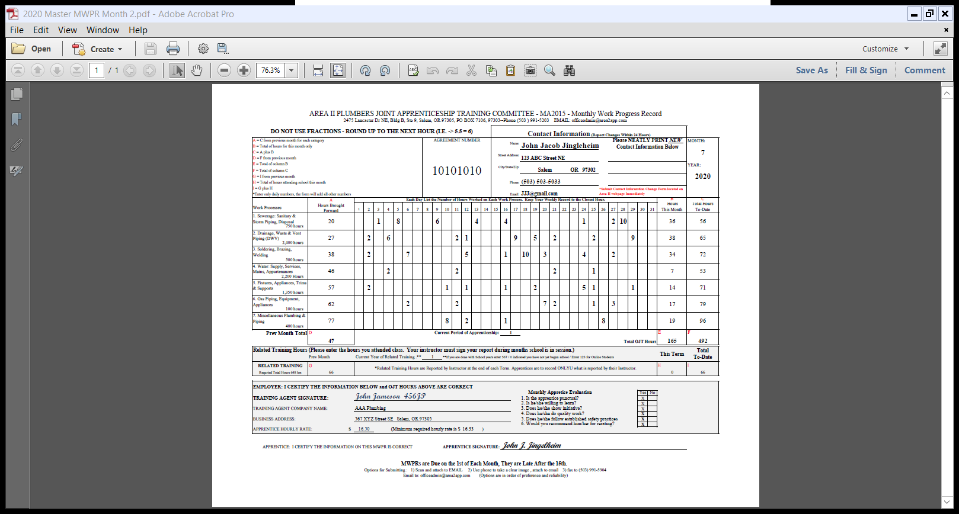
MWPR
Numbers from the previous month’s Total Hours To-Date column will be transferred to the Hours Brought Forward Column.
This keeps a running total of On-The-Job hours.
Notes:
In the example we see how the Total Hours To-Date from January are transferred over into the Hours Brought Forward on the February MWPR. It is important that you pay close attention to these numbers, more often than not when a carryover error is made it is not in the Apprentice’s favor.

Slide 24
MWPR
This section is used to track Related Training Hours (School). At the end of each Term the instructors provide Area II Plumbers JATC with a Grade & Hour Report. Area II Plumbers JATC will then give each Apprentice the hours their Instructor reported for them, at this time the Apprentice will add these reported hours to their current Related Training total.
Notes:
This section is used to track Related Training Hours (School). At the end of each Term the instructors provide Area II Plumbers JATC with a Grade & Hour Report. Area II Plumbers JATC will then give each Apprentice the hours their Instructor reported for them, at this time the Apprentice will add these reported hours to their current Related Training total. The total should be carried over onto each months form, even during the summer when not attending.

Slide 25
MWPR
Training Agents will sign here, verifying that the OJT listed is correct.
Training Agents will answer these questions each month
Notes:
Your Training Agent’s information will be pre-filled by Area II Plumbers JATC. Your Training Agent will also need to answer the questions in this section and sign your MWPR each month.

Slide 26
MWPR
Apprentices must enter their current rate of pay prior to submitting MWPR
Notes:
Enter you actual hourly rate of pay in this section prior to submitting your MWPR. MWPRs submitted without this information are incomplete and will be returned to the Apprentice for correction.
Although there are minimums that Training Agents must pay an Apprentice at each Period, it is not uncommon for them to pay more. In addition Apprentices are employees and eligible for any benefits a Training Agent provides to all other employees. Training Agents may also have a Tuition Reimbursement program. Training Agents like any other employee may have different benefits.

Slide 27
MWPR
Apprentices will sign here each month, attesting that all data entered is correct.
Notes:
The easiest to obtain, and most often forgotten signature, is the Apprentice’s signature. Be sure to double check you MWPR for legibility, correct math, completeness, and for signatures prior to submitting your MWPR to avoid it being returned to you for correction, and the possibility of it being late. There are consequences for late or incomplete MWPRs.

Slide 28
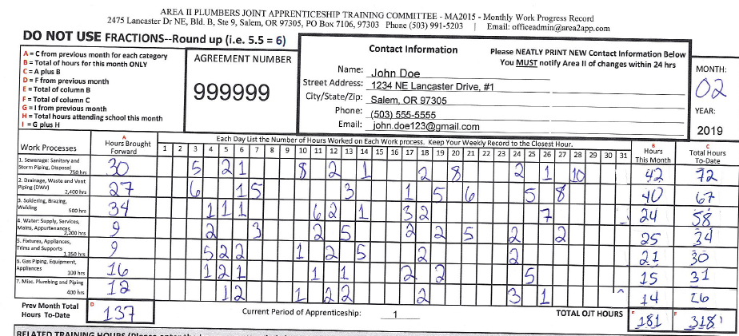
MWPR
White-Out
Do not use White-Out to correct errors.
Corrections should be initialed by your Training Agent (if OJT) or Instructor (if Related Training).
Notes:
Area II Plumbers JATC does not recommend the use of White-out or pencil! BOLI does not like the use of white-out or pencil, and could cause them to disallow a form. If you do use white-out, or make a correction, on your MWPR be sure to have your Training Agent and / or Instructor initial each correction prior to submitting your MWPR to avoid the possibility of having the form returned to you, being late due to making corrections, or being disallowed by BOLI.

Slide 29
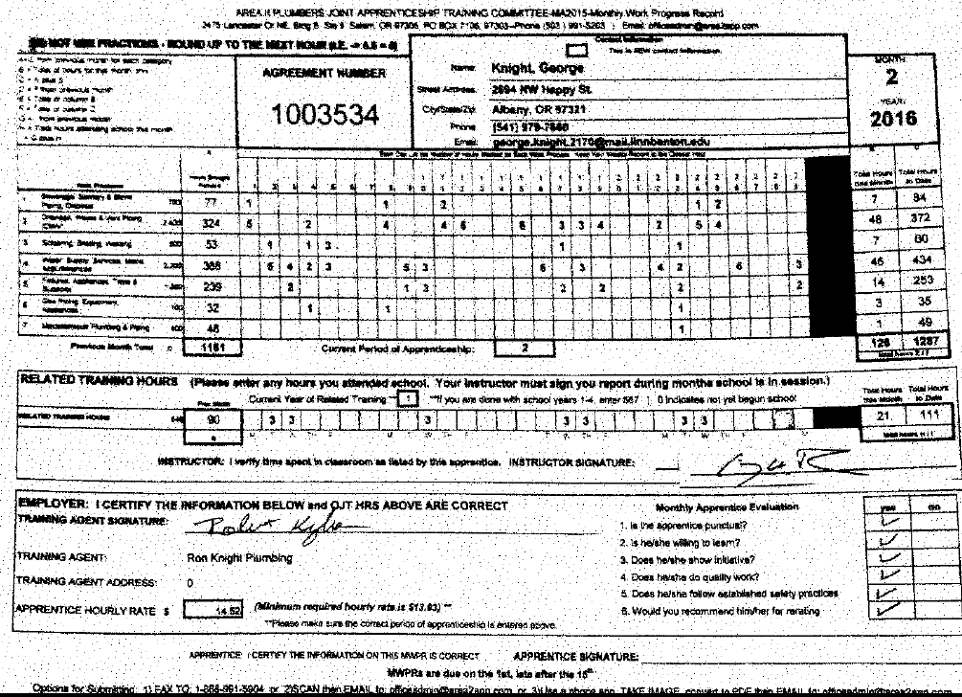
MWPR
Legibility is important
BOLI can disallow an illegible MPWR
Use blue or black pen when completing
Excel MWPR is available
Notes:
Legibility is important, if Area II Plumbers JATC can’t read your form, neither can BOLI…if BOLI cant read it they may disallow it!
Please use blue or black ink. Pencils may not copy well and BOLI considers it too easy to change after the fact and prefers ink.
If you have Excel on your system we do have an Excel MWPR form. This form allows you to enter your hours in the date columns and does the math and carryover for you. If you have Excel and are comfortable with it, you may request an Excel MWPR via email.

Slide 30
MWPR
Submitting Your MWPR
Due on the 1st of the month
Not late until after the 15th
Do not wait until the 15th to submit
MWPRs that are submitted on the 15th with errors, are late
Consequences for late/missing MWPRs
GI Bill Participants
The VA only cuts checks on a specific date each month
The deadline is the 5th of the month, late submissions will result in delay in receiving payment
Notes:
Your MWPR is due on the 1st of each month. Though your MWPR is not late until after the 15th, we strongly recommend that you DO NOT wait until the 15th to submit your MWPR. Allow enough time for Area II Plumbers JATC to check your form, return it to you if there are corrections needed, and for you to make the corrections, obtain any needed signatures or initials, and return the form prior to the deadline. Incorrect forms submitted on the 15th are considered late!
*Veteran Apprentices who are GI Bill participants will need to submit their MWPR by 4:30 pm on the 4th of each month to avoid delays in benefit payment. The VA only cuts benefit checks on a specific date once a month, therefore, missing their deadline (5th of the month) will delay payment until the next scheduled cut date.

Slide 31
MWPR
Submitting Your MWPR
Scan – Attach to email
There are several free scanning apps available
Cam Scanner/Genius Scan are the most used
Image – Attach to email
Entire form
Nothing outside the form
Clear
Not in body of email
Fax – Least recommended / least secure / least clear
Per Area II Plumbers JATC Policies & Procedures Apprentices are to keep a copy of each MWPR
Notes:
You may submit your MWPR via email. MWPRs may be scanned and email as a pdf, this is the preferred method and usually the clearest. There are several free scanning apps available, the most commonly used at this time appears to be Cam Scanner & Genius Scan.
You may also take a picture of the MWPR and attach it to an email. When taking a picture of your MWPR be sure to get the entire form, but nothing outside the form. Incorrectly submitted or blurry image will be returned for correction. Do not place the image in the body of the email as this often compresses the image and creates issues on the receivers end.
Although you can fax your MWPR in, this is the least reliable and usually the least clear method of submitting. We do not recommend faxing your form.
Per Area II Plumbers JATC Policies & Procedures Apprentices are to keep a copy of each MWPR throughout their Apprenticeship.

Slide 32
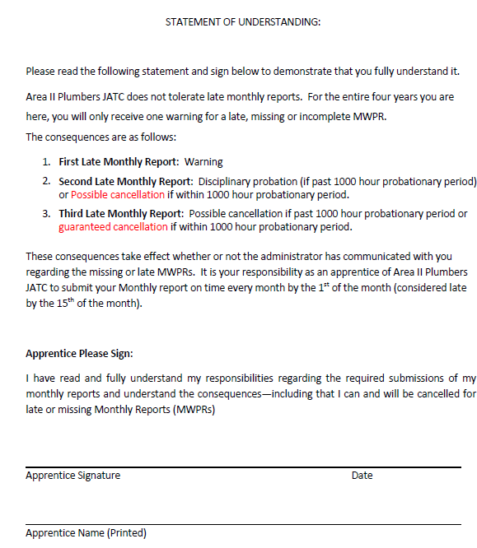
MWPR
Apprentice keep
copy of Sample
MWPR
Sign Statement
of Understanding
Notes:
The next document in the packet is a Statement of Understanding. This form states that you understand the MWPR, and the consequences for late or missing MWPRs.
First offense is an official warning which will be placed in your file. A second offence will result in a Cite to Appear before the Committee, and possibly Disciplinary Probation.
When placed on Disciplinary Probation an Apprentice is not eligible to be Re-rated or hold a Phase (we will cover phasing a little later). However, if you are still in your probationary period this will likely result in an immediate cancellation of your Apprenticeship without the right to appeal.
A third office will result in a Cite to Appear, possible Disciplinary Probation or Cancellation.
Please sign and date this document and turn it in.

Slide 33
Related Training
Chemeketa
Apprentices are responsible for registering
each semester
September – May
2 nights a week, 3 hours a class
Minimum Requirement – 156 hours / year
3 absences/ year
Consequences for more absences
Notes:
Area II Plumbers JATC uses Chemeketa Community College for Related Training classes. This allows Area II to keep the costs of schooling to a small portion of the One Hundred Thousand Dollar ($100,000.00) price tag for a four year college. Chemeketa Charges approximately six hundred dollars ($600.00) a Semester, eighteen hundred ($1,800.00) a year, if you do not have to retake a class six thousand dollars ($7,200.00) for the entire program.
Apprentices are responsible for registering each term with Chemeketa, though Area II Plumbers JATC and your instructors will likely give you reminders. Failure to register to Related Training will result in a Cite to Appear before the Committee, possible disciplinary action, or cancellation.
Chemeketa adheres to a standard school year, September through May, with winter and spring breaks, as well as summer break. Apprentices will attend classes 2 nights a week, for three hours a class.
The minimum yearly requirement is 156 hours of Related Training time. An Apprentice may miss up to 3 classes a year. However, you will need to notify both your Instructor and Area II Plumbers JATC with both notice of the missed class and the reason for the missed class. Training Agents are required to release Apprentices from work in time to make it in time to Related Training classes. This does not mean in time to run home and change, have dinner, etc.

Slide 34
First Aid / CPR Card
BOLI requires all Apprentices to obtain, and maintain a First Aid / CPR certification throughout their Apprenticeship.
Notes:
BOLI Requires all Apprentices to obtain and maintain a First Aid / CPR certification throughout their Apprenticeship. Chemeketa offers a class at a discounted rate, however, you may take any certified class.

Slide 35
Related Training
Grade Requirements
Must pass class with C Average
D is not a passing Grade
May only retake failed class once
Disciplinary Probation if not meeting grade requirements
Notes:
Although Chemeketa may consider a D as a passing grade, the Area II Plumbers JATC Committee does not. Apprentices are required to pass all Related Training classes with at least a C average. You may retake a class if you fail it, however, you may only retake it once. Failing to meet grade requirements will result in a Cite to Appear, and possibly disciplinary action, or cancellation of Apprenticeship. As classes are held in order, this may also add as much as a year onto your Apprenticeship as you may have to wait until after the end of the 4th year to retake a failed class.

Slide 36
Related Training
Common Error that can cost an Apprentice
When applying at Chemeketa be sure to read all questions thoroughly
Be sure to answer the residency question stating that you have been a residence of Oregon
A wrong answer can more than double your tuition!
Check out Apprentice Resources on
Area II Plumbers JATC website for
scholarships
Notes:
When applying to Chemeketa in the Fall be sure you answer the residency question that you have been a resident of Oregon for more than 90 days. Failure to answer this question correctly can cost an Apprentice, more than doubling the Apprentice’s tuition as Chemeketa would consider you an out-of-state student!
Check our Apprentice Resources on the Area II Plumbers JATC website. We have listed several scholarships specific to plumbing! These scholarships are yearly, and do not all have the same deadline. We recommend that you check regularly for availability and apply to as many as are available.

Slide 37
Communication
Email
Preferred
In writing
Set-up new email?
Phone
Apprentices must reply within 24 hours
Voicemail set-up
Notes:
Communication is extremely important to the Area II Plumbers JATC Committee! Non-Communication may result in Cite to Appear, disciplinary action, or even cancellation.
Email is our preferred method of communication, it allows for everything to be in writing for easy review, and time for research of the answers if needed. Some Apprentices have set up a new email once entering the program, for professional communication because their current email has an unflattering name, or because it already receives so much email that professional communications would be lost.
We are aware that you will likely be working during the same hours we are and may not be able to answer when we call. However, if we call please note that it is very important. Apprentices must reply to communications within 24 hours. Be sure your voicemail is set-up on your cell phones.

Slide 38
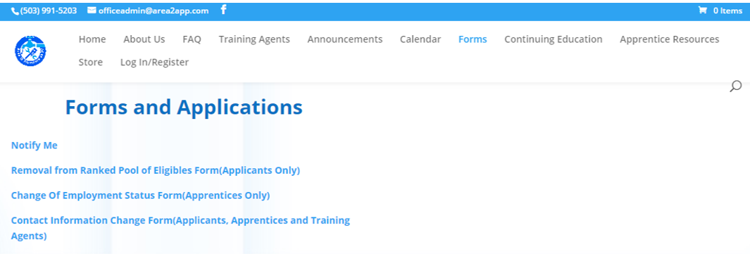
Communication
24 hour notice on status changes
Training Agent
Contact Information
Website
Notes:
Apprentices must notify Area II Plumbers JATC of a change in status within 24 hours. A change in status includes changing your Training Agent or changing your contact information. On the Area II Plumbers JATC web site on the Forms page there are two forms for use by Apprentices to notify Area II of a change. The Change of Employment Status is for changes of Training Agents; whether you are fired, resign, or are laid-off you must complete this form within 24 hours.
The Contact Information Change Form is for a change in: address, phone number, or email. Apprentice’s must submit this form within 24 hours of a change, even if their new information is entered onto their MWPR. It is important that we keep our records updated as BOLI receives your contact information from Area II, but it is BOLI that sends out your Apprentice License. Returned mail can take months to cycle through the mail before being returned. In that time your Apprenticeship license may lapse causing you to be unable to work!

Slide 39
Apprenticeship License
Must carry your license at all time
Must show your license when requested
MWPR & BOLI Agreement Number
Approximately 2 – 3 weeks after approved by Area II Plumbers JATC Committee
Email MWPR at this time
Keep MWPR with you
Notes:
Apprentices must carry their license with them at all times. Though in some work environments it would be inadvisable to carry your license (or even your wallet) on your person, you must have your license in an accessible (and safe) place such as the glove compartment of your personal or work vehicle.
You must show your license if requested by a representative of BOLI or the Building Codes Division. Representatives of these agencies often come to work sites and do a license check, and have been known to follow plumbers from job site to job site. If you are found out of compliance by one of these agencies your Training Agent may be fined, but you may lose your license and be cancelled from the Apprenticeship. Apprentices cancelled from the program must wait a calendar year, and then must go through the Open Enrollment process. This could cause a year, or perhaps even two delay, in your Apprenticeship. During that delay you would not be able to work as an Plumber, and your Apprenticeship license will be void!
Your BOLI agreement number is another method for inspectors to check your license status, though this method is only acceptable when you have first joined the program and have not yet received your license, or for a short time if your wallet is lost. It will take approximately 2 to 3 weeks to receive your Agreement number from BOLI (this may vary due to COVID as BOLI Representatives are primarily working from home).
Area II Plumbers JATC will receive your Agreement number before you receive your license in the mail. Once Area II Plumbers receives your Agreement number we will email you your MWPR, from that day you are an Apprentice and may begin to track your OJT hours. Keep your MWPR with you at all times, you won’t remember what hours and in which Processes you worked on Monday on Friday!

Slide 40
Apprenticeship License
CANNOT PRACTICE AS AN APPRENTICE WITHOUT A LICENSE
Receive via USPS from BOLI
Must work for an Area II Plumbers JATC Registered Training Agent
Notes:
You CANNOT PRACTICE AS AN APPRENTICE WITHOUT A LICENSE. If you receive your license before you receive your MWPR (it’s rare but has happened) notify Area II Plumbers JATC immediately! If you are found working without a license or outside of the purview of Apprenticeship (working without your Training Agent is considered illegal plumbing work) you will likely lose your license and your Apprenticeship! Even work done for family or friends can be reported and land you in a position that may cost you a year or more of your Apprenticeship.
You must remain employed by an Area II Plumbers JATC Registered Training Agent through out your Apprenticeship. Working with a Plumber who is not a Registered Training Agent is considered illegal plumbing.

Slide 41
Journeyman to Apprentice Ratio
Be Aware of the Ratio
1/1 up to 2 Apprentice
Three extra Journeymen for over 2 Apprentices
Fines / Action for being out of Ratio
Training Agent fined
Apprentice could lose license
Notes:
The next page in your packet, is for you to maintain, and concerns Journeyman to Apprentices Ratio.
The ratio is important, and one of the many things that field reps for BOLI or Building Codes Division will be looking for when they visit a job site. Up to two (2) Apprentices the ratio is 1 to 1. However, over two Apprentices there will need to be an additional three (3) Training Agents for the additional Apprentices!
If found out of Ration the Training Agent can be fined, and an Apprentice may lose their license.

Slide 42
Journeyman to Apprentice Ratio
Available on Area II Plumbers JATC web site
Notes:
The Journeyman to Apprentice Ratio is also available on the Area II Plumbers JATC web page.

Slide 43
Phased Supervision
Phased Supervision is Requested by Training Agent
Phased Supervision - Apprentice may work independently within specific parameters
There are 4 Phases
The first is available early in the Apprenticeship, allow for work on water heaters
The second is available at 4th Period
The third is available at 5th Period
The fourth is available at 6th Period
Notes:
Training Agents may request Phased Supervision for their Apprentices. Phased Supervision allows the Apprentice to work independently within specific parameters, each Phase allowing for a more independent work. Apprentices who are phased are required to keep a log, and report to their Training Agent to review their work.
The first Phase is available early in the Apprenticeship, and allows the Apprentice some work on water heaters. Phase 2 is available when the Apprentice has reached 4th Period. The Third is available when the Apprentice reaches 5th Period. The 4th and final Phase is available when the Apprentice reaches 6th Period.
Phases are indicated on an Apprentices license. Phases are rescinded during Disciplinary Probation or if the Apprentice changes Training Agents, and must be reapplied for once probation is lifted or by the new Training Agent. *You CANNOT work as a phased Apprentice until you have the updated license!

Slide 44
Code Book
Must have a Code Book prior to beginning of Related Training
Area II Plumbers JATC sells them for $150.00
Available online through Store
Pick-up here at office
Or $10.00 shipping
2017 Code Books – order from IAPMO website
Code Books are updated every 3 years
2021 Code Books out in April
Notes:
Code books are required prior to beginning Related Training. Area II Plumbers JATC has them available on our web site through the Store for what we pay for them; one hundred fifty dollars ($150.00). When ordering you must be pay through the website (we do not accept any form of payment in the office), you can pick them up here in the office, or for a ten dollar ($10.00) fee they can be shipped to you.
Area II is currently out of the 2017 Code Books. If Area II is able to sell them at $150.00 because we purchase them in bulk and receive a discount for doing so. With the small number needed at this time the cost would be significantly higher. Therefore, we recommend you order them directly from IAPMO, they are available in both hardback binder book or downloadable pdf.
Code Books are updated every 3 years. The current book was release in 2017, the next version would normally be released in October of 2020. However, due to COVID the release has been pushed back to April 01, 2021. Changes are noted in the book by a mark next to the new or changed section for easy review.

Slide 45
Office Hours
Monday to Thursday 8:00am- 12:00 pm 1:00 pm-5:00pm
Phones will not be answered after 4:45pm
Friday Office is Closed
Notes:
Office is opened Monday to Thursday from 8:00 am to 5:00 pm, we are closed for lunch from Noon to 1:00 pm. Phones will not be answered after 4:45pm. Office is closed Fridays, guest are not accepted, employees may be working, however, phones are not monitored or answered.

Slide 46
Questions

Slide 47
Thank You.

